Slide 1
HW#1
Wen-Yen Hsu
Dept Electrical Engineering
Chang Gung University, Taiwan

Slide 2
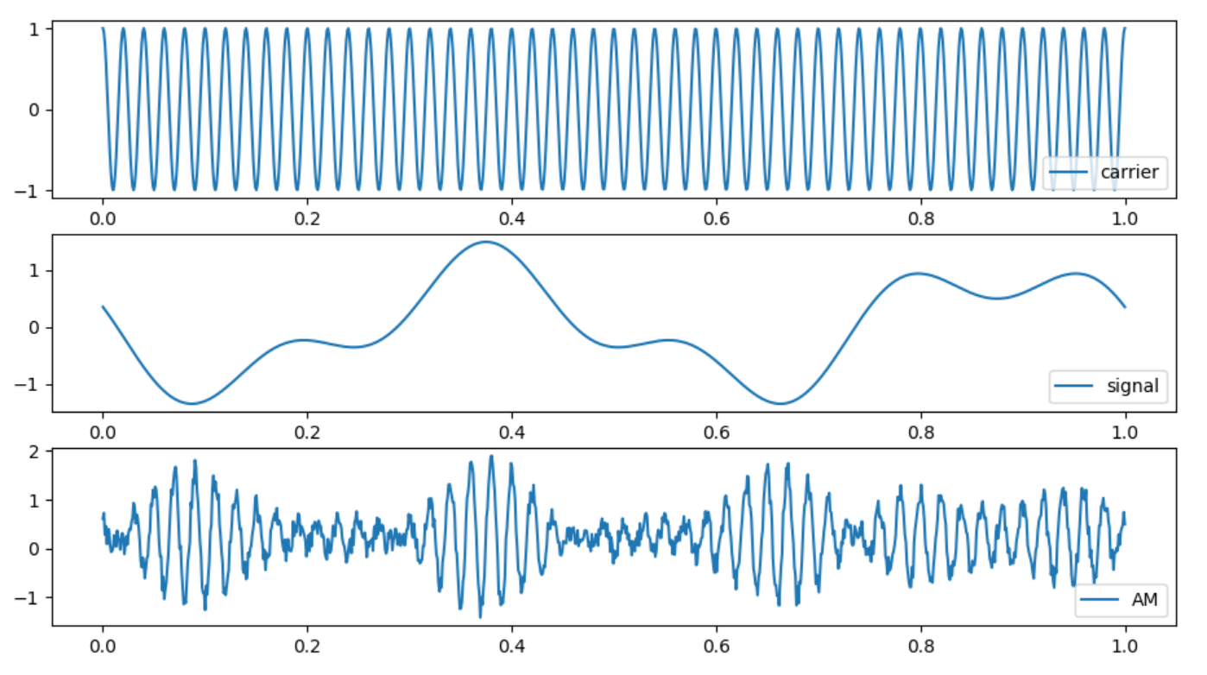
AM Modulation
AM is an old modulation method, please use the skills learned today to draw the following picture. Add noise to simulate the real situation.

Slide 3
Exercise Hint
#import module
#frequency
f_c = 50 #50Hz
...
#time
t = np.linspace(0, 1, 1000)
#carrier
carrier = np.cos(2*np.pi*f_c*t)
#signal
signal =
#am = signal*carrier
am =
am = am + 0.5*np.random.rand(1000)
#plot
...
plt.show()

Slide 4
AM Modulation Implement
#import module
import matplotlib.pyplot as plt
import numpy as np
#frequency
f_c = 50 #50Hz
f_1 = 2 #2Hz
f_2 = 5 #2Hz
#time
t = np.linspace(0,1,1000)
#carrier
carrier = np.cos(2*np.pi*f_c*t)
#signal
S1 = np.cos(2*np.pi*f_1*t + 0.5*np.pi) #degree 90
S2 = 0.5*np.cos(2*np.pi*f_2*t + 0.25*np.pi) #degree 45
signal = S1 + S2
#am = signal*carrier
am = signal*carrier
am = am + 0.5*np.random.rand(1000)
#plot
plt.subplot(311)
plt.plot(t,carrier,label=str('carrier'))
plt.legend(loc="lower right")
plt.subplot(312)
plt.plot(t,signal,label=str('signal'))
plt.legend(loc="lower right")
plt.subplot(313)
plt.plot(t,am,label=str('AM'))
plt.legend(loc="lower right")
plt.show()

Slide 5
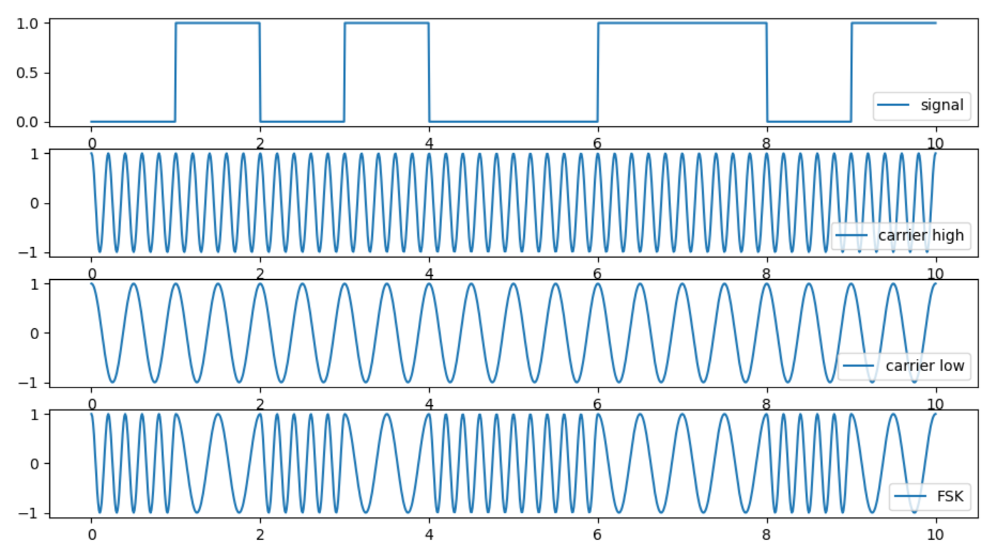
FSK Modulation
FSK is a digital modulation technology that uses two different frequencies to encode the signal. Please draw the following picture.
f high = 5 , f low = 2 , bit stream = 0101001101

Slide 6
Exercise Keynote
Array creation
Understanding the relationship between np.linspace and plot result
Control flow (for…, if…)
Array split and combination
Using function (optional)

Slide 7
FSK Main Architecture
import matplotlib.pyplot as plt
import numpy as np
# given condition
bit_stream = np.array([0, 1, 0, 1, 0, 0, 1, 1, 0, 1])
f_low = 2 #2Hz
f_high = 5 #5Hz
# decide by yourself
total_point = 1000
# execution
signal, carrier_high, carrier_low, fsk, t = FSKmodulation(bit_stream, f_low, f_high, total_point)
# plot results
plt.subplot(411)
plt.plot(t,signal,label=str('signal'))
plt.legend(loc="lower right")
plt.subplot(412)
plt.plot(t,carrier_high,label=str('carrier high'))
plt.legend(loc="lower right")
plt.subplot(413)
plt.plot(t,carrier_low,label=str('carrier low'))
plt.legend(loc="lower right")
plt.subplot(414)
plt.plot(t,fsk,label=str('FSK'))
plt.legend(loc="lower right")
plt.show()

Slide 8
FSKmodulation() Implement
def FSKmodulation(bit_stream, f_low, f_high, total_point):
# basic setting
bit_stream_length = bit_stream.shape[0]
pt_per_bit = int(total_point/bit_stream_length)
t = np.linspace(0, bit_stream_length, total_point)
# generate two carriers
carrier_high = np.cos(2*np.pi*f_high*t)
carrier_low = np.cos(2*np.pi*f_low*t)
# multiplexer
for i in range(bit_stream_length):
# according to bit_stream state choose carrier
if bit_stream[i] == 0:
fsk_now = carrier_high[i*pt_per_bit:(i+1)*pt_per_bit]
signal_now = np.zeros(pt_per_bit)
if bit_stream[i] == 1:
fsk_now = carrier_low[i*pt_per_bit:(i+1)*pt_per_bit]
signal_now = np.ones(pt_per_bit)
# link sequence
if (i == 0):
fsk_past = fsk_now.copy()
signal_past = signal_now.copy()
else:
fsk_past = np.concatenate((fsk_past, fsk_now),axis=0)
signal_past = np.concatenate((signal_past, signal_now),axis=0)
return signal_past, carrier_high, carrier_low, fsk_past, t

